Slide 1
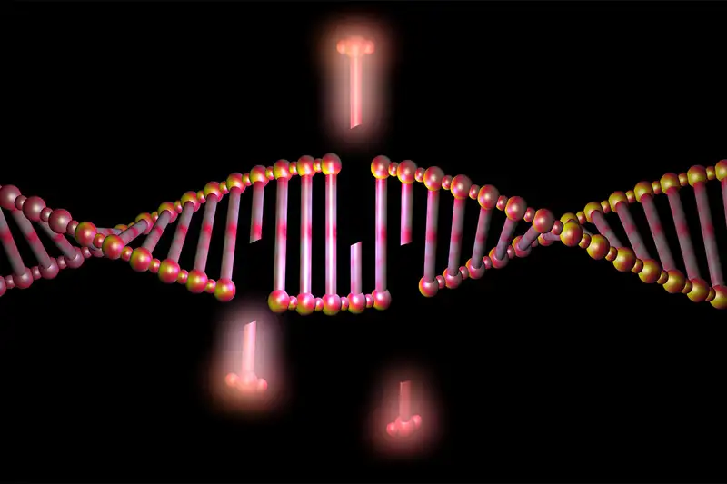
Precise is Nice:
Specific, accurate, exact, on-point, and direct targeting for the treatment of PTSD
(and Alzheimer’s Disease)
By
Jazmine
Yaeger

Slide 2
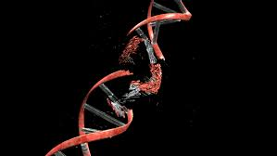

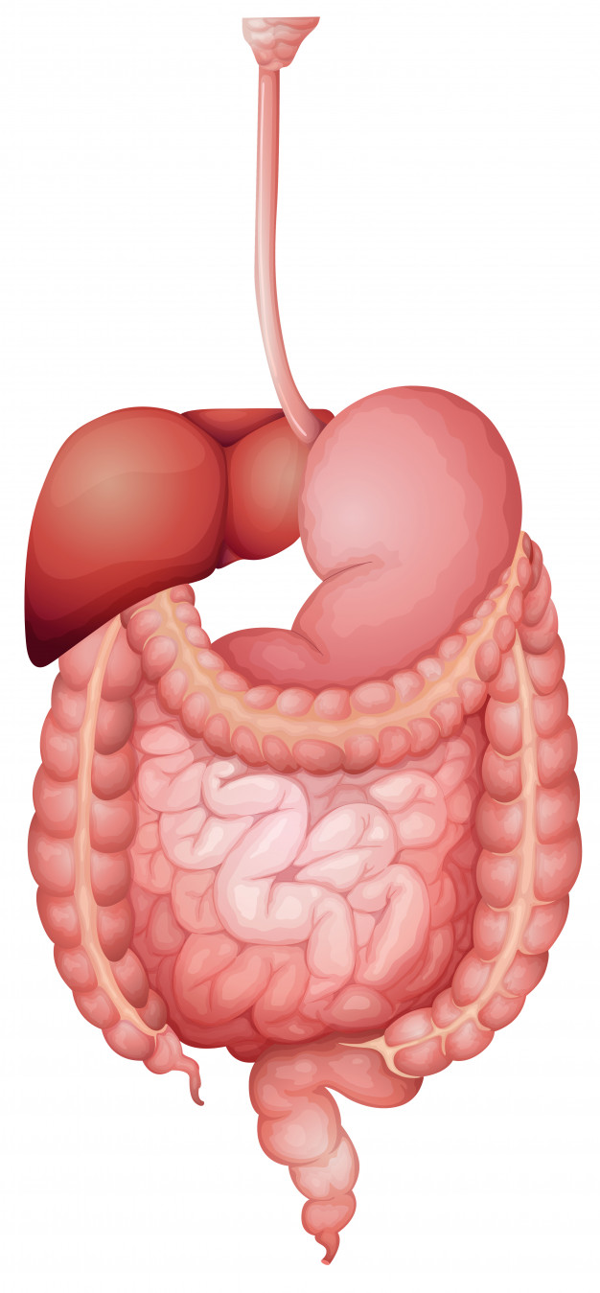
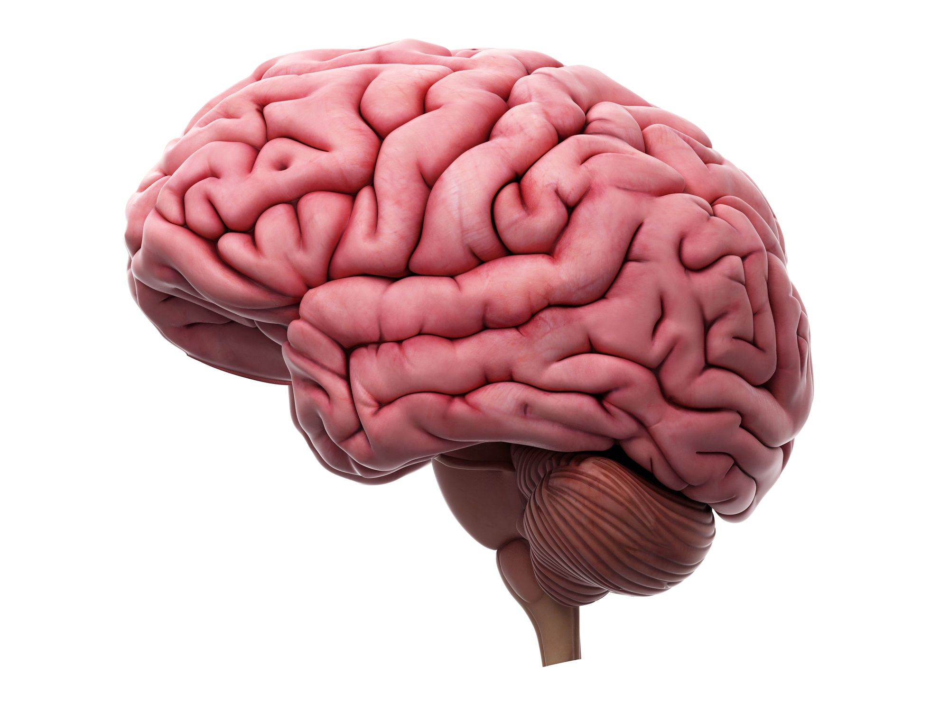
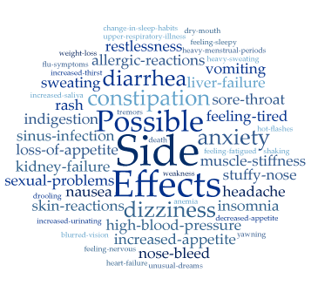


The Problem
More on this later...
Solved?

Slide 3
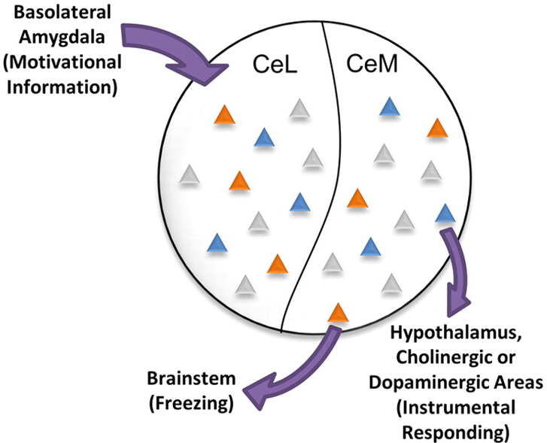
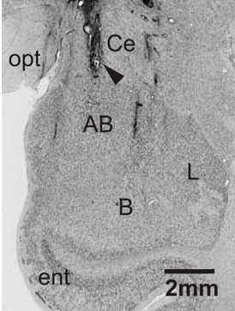
The Problem
More on this stuff later too...
O
X
The Goal:
Precise Delivery of Therapeutic Agents
X
X
X
X
X
X
O
X
X
X
Target source of problem
Avoid unwanted side effects
Personalization of treatment
X
X
X
X
X
O
X
X
X
X

Slide 4



The Example (#1)
Post-Traumatic Stress Disorder (PSTD)

Slide 5


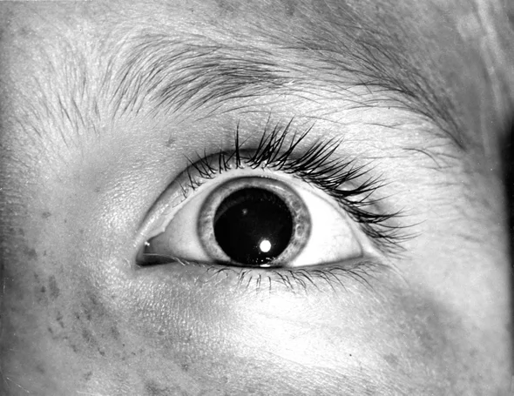

The Example (#1)
Post-Traumatic Stress Disorder (PSTD)
Intrusive Memories
Avoidance
Negative Changes in Thinking/Mood
Changes in Physical/Emotional Reactions
MayoClinic.org

Slide 6

The Example (#1)
Post-Traumatic Stress Disorder (PSTD)
Comorbid with other disorders:
  Alcoholism
  Specific Anxiety Disorders
  Depression
  Eating Disorders
  Sleep Disorders
  Alzheimer’s Disease
Perkonigg, A., et al. 2000. Acta Psychiatrica Scandinavica 101(1): 46-59.
Ohayon, M. M. 2013. Sleep Medicine 14(6): 488-492.
Weiner, MW et al. 2013. 9, 445-451.

Slide 7
The Example (#1)
Post-Traumatic Stress Disorder (PSTD)
Glu
IL
Hold up...
Let’s talk LH/DMH-PeF
mPFC
CeA
PrL
EC
lCeA
PAG
Glu
lcCeA
Glu
“Off”
mCeA
dl/lPAG
Mc
LA
“On”
Glu
mpITC
GABA
GABA
lpITC
GABA
GABA
Glu
ACh
Glu
GABA
?
vlPAG
GABA
Glu
HYPOTHALAMUS
(PeF)
ACh
SC
GABA
BLA
FEAR RESPONSE

Slide 8
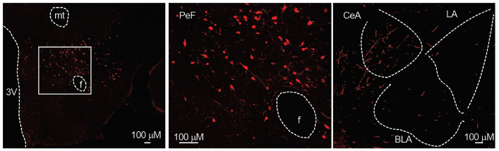
The Example (#1)
LH/DMH-PeF (Just Areas of the Hypothalamus)
Regulates:
  Motivated Behaviors
  Wakefulness
  Stress Responses
Hold up again...
What is an orexin?
Red = Orexin (Orx_{A} to be precise)
Dustrude, ET et al. 2018. Frontiers in Neuroscience 12.

Slide 9
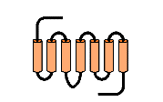
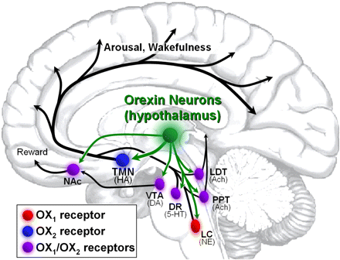
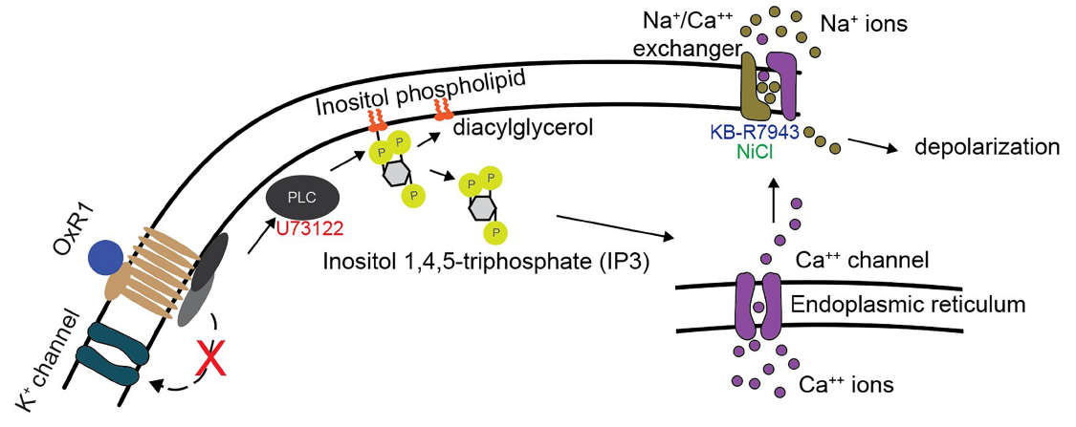
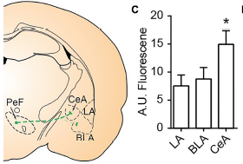

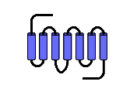
The Example (#1)
An Orexin (More specifically ‘Orexins’)
LH-DMH/PeF
Orx₂
How exactly are orexins working in the CeA?
Prepro-Orexin
Orx_{A}
Orx_{B}
Orx₁
Orx₁ > Orx₂
Dustrude, ET et al. 2018. Frontiers in Neuroscience 12.
Gotter, AL, et al. 2012. Pharmacological reviews 64, 389-420.

Slide 10
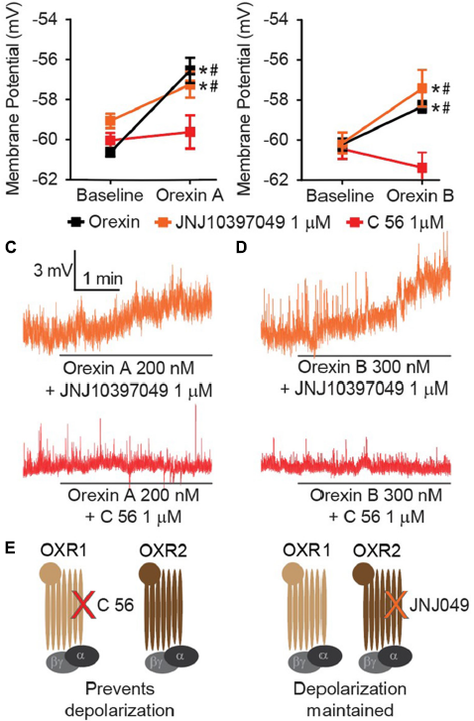
The Example (#1)
Orexins at Work in the CeA
Looks like Orx₁ is the point of action in the CeA...
This was further validated using DREADDs
???
Orx₂ Antagonist Orx₁ Antagonist
Dustrude, ET et al. 2018. Frontiers in Neuroscience 12.

Slide 11
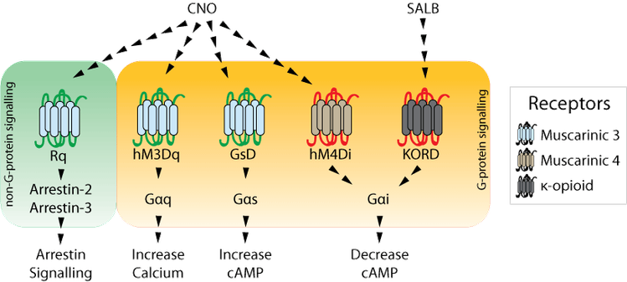
The Example (#1)
DREADDs are Cool
Designer
Receptor(s)
Exclusively
Activated by
Designer
Drugs
AAV1-Hcrt-hM3Dq-mCitrine
Adeno-Associated Virus (Serotype 1)
Prepro-Orexin Promoter
DREADD Gene
Fluorescent Protein Reporter
Addgene.com.

Slide 12
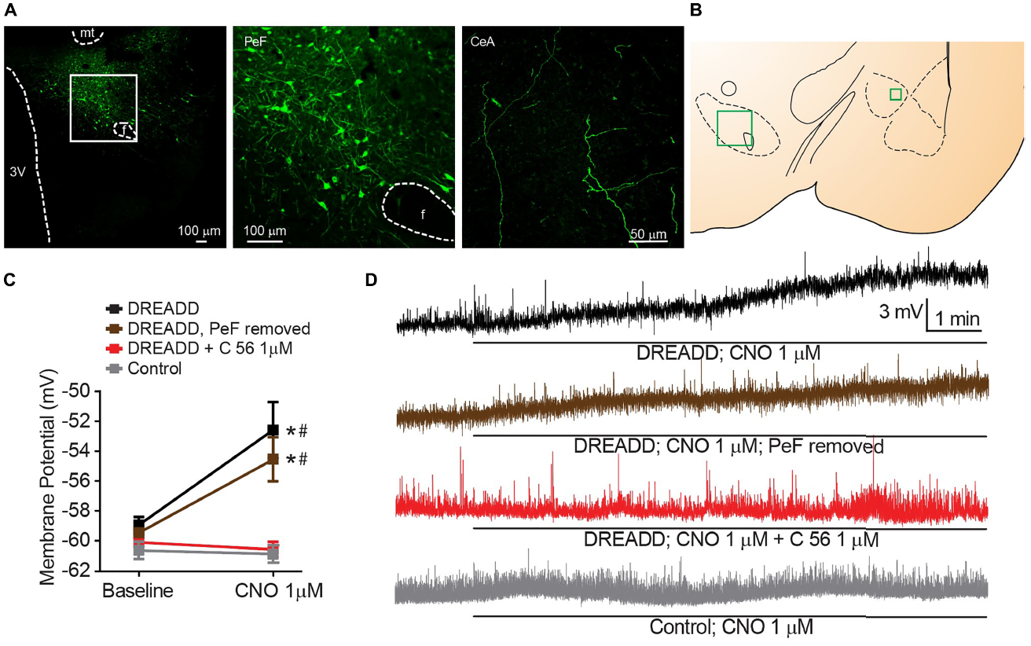
The Example (#1)
Further Validation with DREADDs
Yep...Looks like Orx₁ is the point of action in the CeA
How does Orx₁ work?
Dustrude, ET et al. 2018. Frontiers in Neuroscience 12.

Slide 13
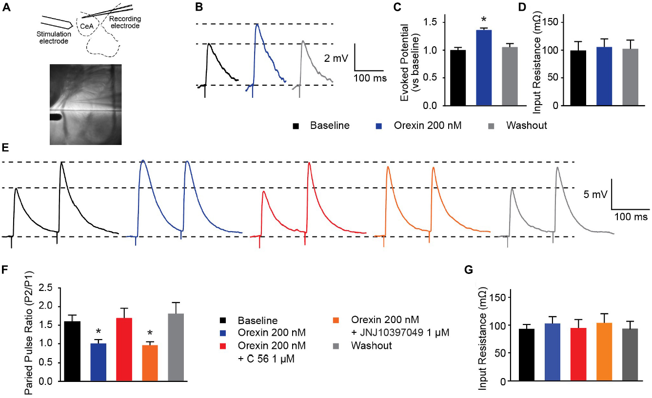

The Example (#1)
BLA Projection
Neuron?
Orx₁ Acting Presynaptically?
Orx₁ Receptor
Neat...But what does all of this have to do with PTSD?
Orx_{A}
Orx₁ Antagonist
Glutamate (AMPA, NMDA) Receptors
CeM Neuron
Orx₂ Antagonist
Dustrude, ET et al. 2018. Frontiers in Neuroscience 12.

Slide 14

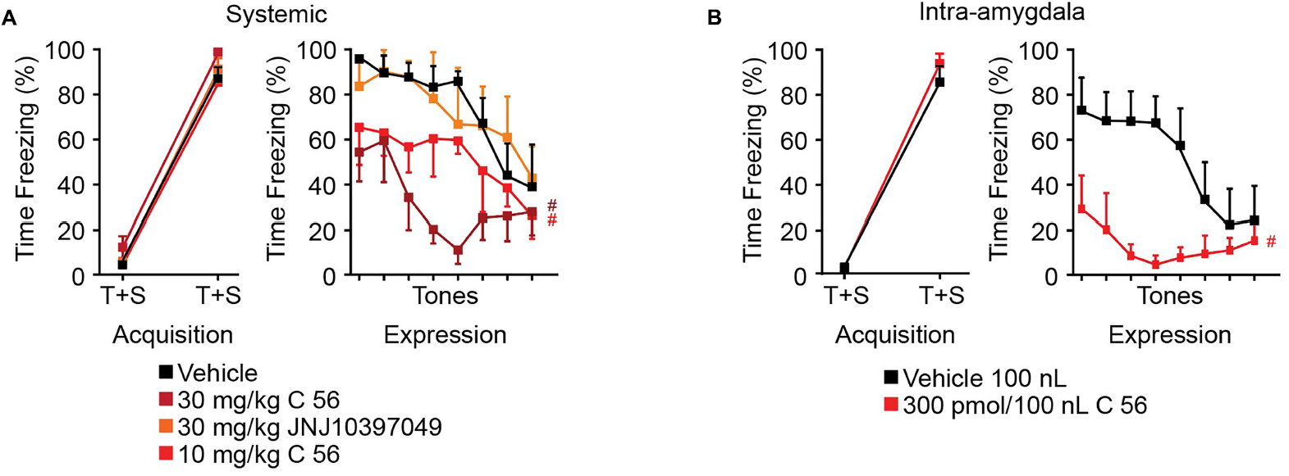
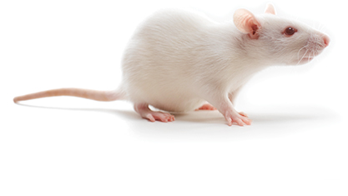

The Example (#1)
Orx₁ Inhibition Reduces Cued Fear Response
Dustrude, ET et al. 2018. Frontiers in Neuroscience 12.

Slide 15
The Example (#1)
Orx₁ is abundant in the CeA
Orx₁ influences presynaptic glutamate release in the CeM
Orx₁ inhibition can reduce fear response
Glu
IL
mPFC
CeA
PrL
EC
lCeA
PAG
Glu
lcCeA
Glu
“Off”
mCeA
dl/lPAG
Mc
LA
“On”
Glu
mpITC
GABA
GABA
lpITC
GABA
GABA
Glu
ACh
Glu
GABA
vlPAG
GABA
Glu
HYPOTHALAMUS
(PeF)
ACh
SC
GABA
BLA
Dustrude, ET et al. 2018. Frontiers in Neuroscience 12.
FEAR RESPONSE

Slide 16

The Example (#1)
Problem Solved?
The Goal:
Precise Delivery of Therapeutic Agents
Side Effects May Include:
Daytime sleepiness/drowsiness
Decreased energy levels
Reduced appetite
Lack of motivation
Fearbegone®
(Orx₁ Antagonist)
Take as needed to reduce uncontrollable fear-related anxiety or depression
Kiyashchenko, L. I., et al. 2002.. Journal of Neuroscience 22(13): 5282-5286.
Hagan, J. J., et al. 1999. Proceedings of the National Academy of Sciences 96(19): 10911-10916.
Sakurai, T., et al. 1998. Cell 92(4): 573-585.
Borgland, SL et al. 2009.. Journal of Neuroscience 29, 11215-11225.

Slide 17

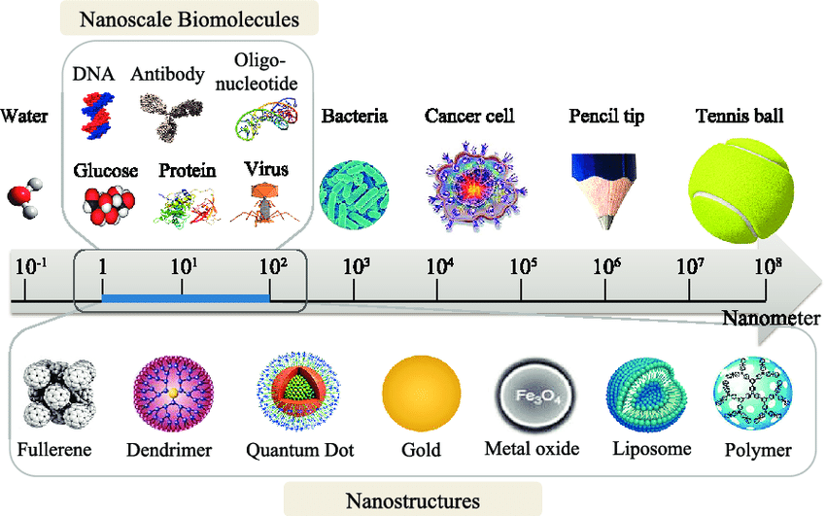
The Solution?
These have a cool name...let’s explore these a bit more...
Nanoparticles?

Slide 18
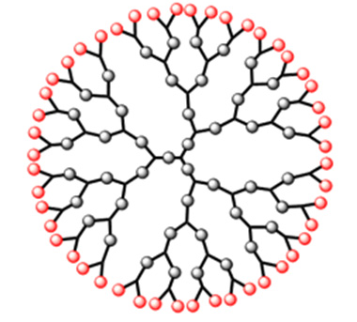
The Solution?
Dendrimers
Spherical
Symmetrical
Single Core
  With Branches
Outermost shell may be functionalized
Pathak, A., et al. 2009. Biotechnology Journal 4(11): 1559-1572.

Slide 19
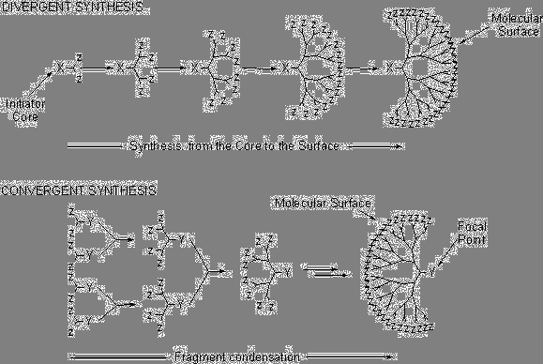
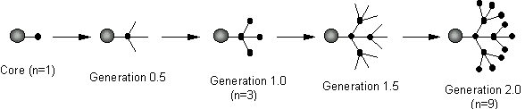
The Solution?
Dendrimers
http://www4.utsouthwestern.edu/jdebralab/dendrimer.htm

Slide 20
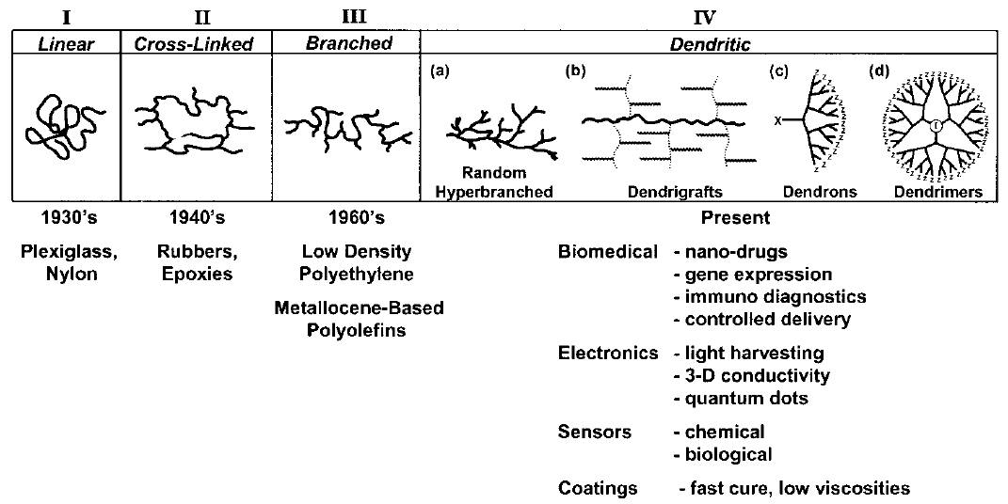
The Solution?
Dendrimers
Tomalia, DA & Fréchet, JM 2002. Journal of Polymer Science Part A: Polymer Chemistry 40, 2719-2728.

Slide 21
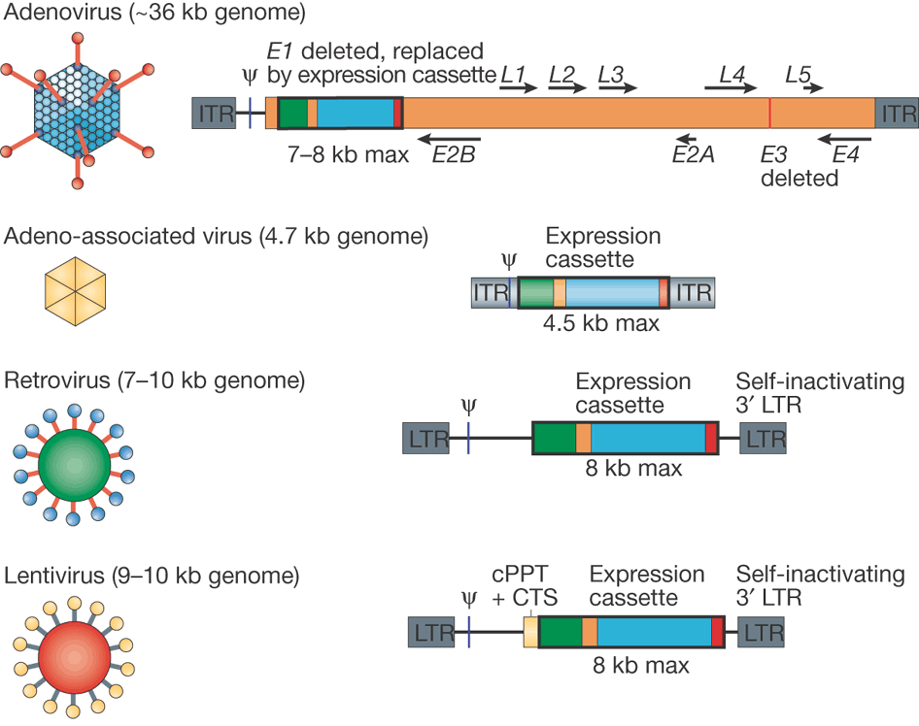
The Solution?
NPs vs Viruses
Negative perception
Limited storage capacity
Deadly immune response
Insertional mutagenesis
Only a few infect neurons
Expensive and complicated
Can NPs help us reach “The Goal?”
Sheridan, C. 2011. Nature Biotechnology 29: 121.

Slide 22

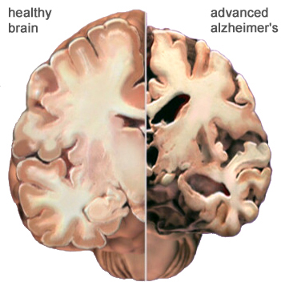
The Example (#2)
Alzheimer’s Disease (AD) is Bad
Symptoms
  Attention/memory decline
  Disruption of sleep
  Increasing dependence
  Speech difficulties
  Behavioral changes
  Abrupt moodiness
  Death (3-9 years after diagnosis)
Heavily researched, but still not fully understood
Brain Atrophy
  Characterized by:
    Shrunken Cortex
    Expanded Ventricles
    Diminished Hippocampus

Slide 23
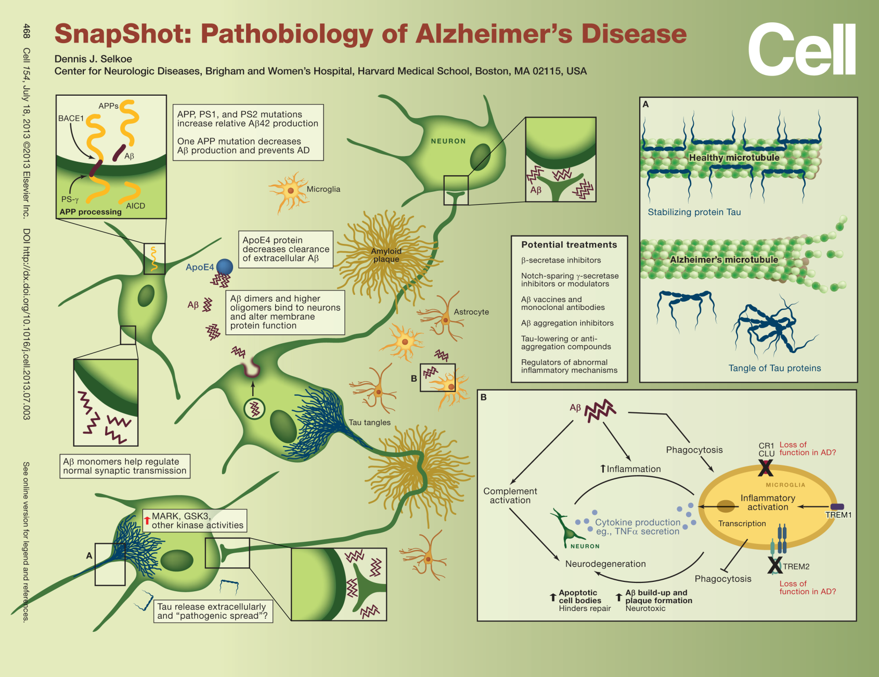
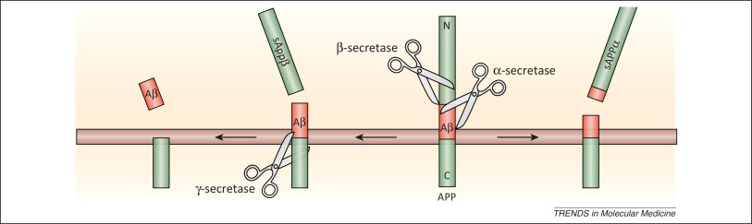
The Example (#2)
Alzheimer’s Disease (AD) is Bad
Can a targeted approach be used to treat AD?
BACE1
Selkoe, D. J. 2013. Cell 154(2): 468-468. e461.
Perneczky R. et al. 2014. Trends Mol Med. 20(1):8-15.

Slide 24
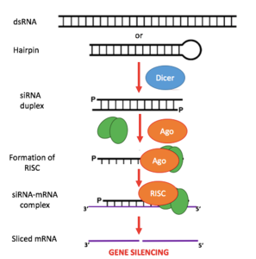
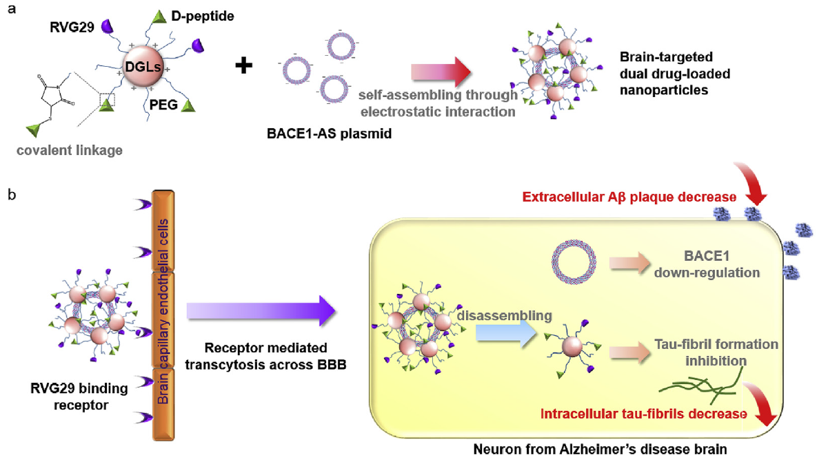
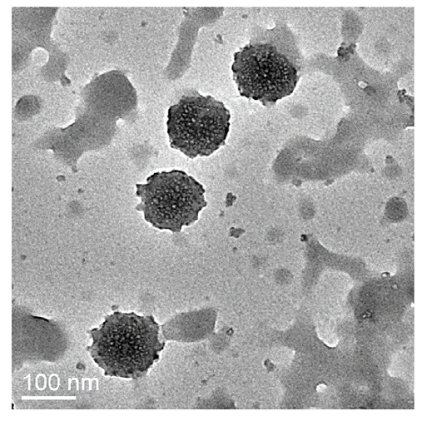
The Example (#2)
Rabies Virus Glycoprotein (29 aa)
D-TLKIVW
Nanoparticle Complex
Can RVG29 help treatments cross the BBB?
Polyethylene Glycol
Dendrigraft
Poly-L-Lysines
BACE1 Antisense Plasmid
Liu, Y et al. 2016. Biomaterials 80, 33-45.

Slide 25
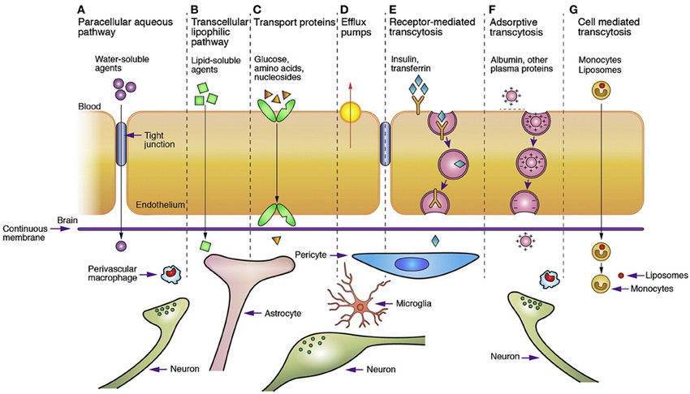
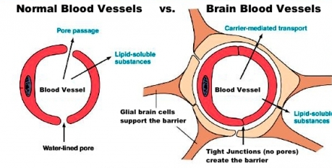
The Example (#2)
BBB means Blood Brain Barrier

Slide 26
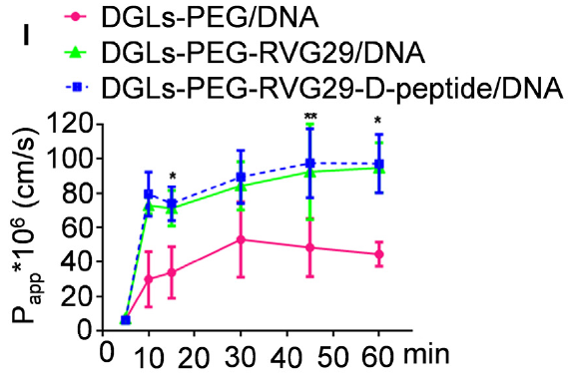
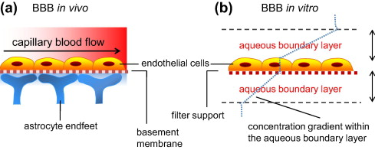
The Example (#2)
RVG29 Escorts Nanoparticle Complex Across in vitro BBB
Yusof, S., et al. 2014. European Journal of Pharmaceutical Sciences 65.
Liu, Y et al. 2016. Biomaterials 80, 33-45.

Slide 27
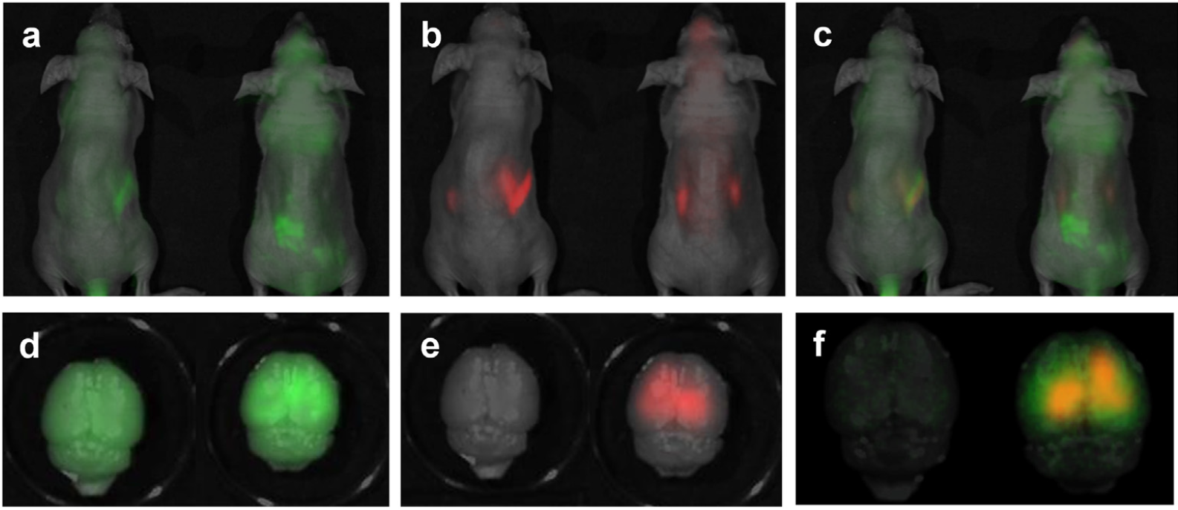
The Example (#2)
RVG29 Escorts Nanoparticle Complex Across in vitro BBB
DNA
Peptide
Merged
Great! We see crossing of the BBB…
But what about therapeutic outcomes?
No RVG29
No RVG29
No RVG29
Liu, Y et al. 2016. Biomaterials 80, 33-45.

Slide 28
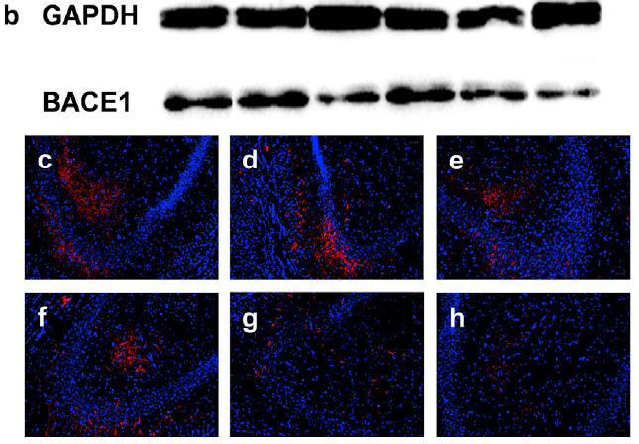
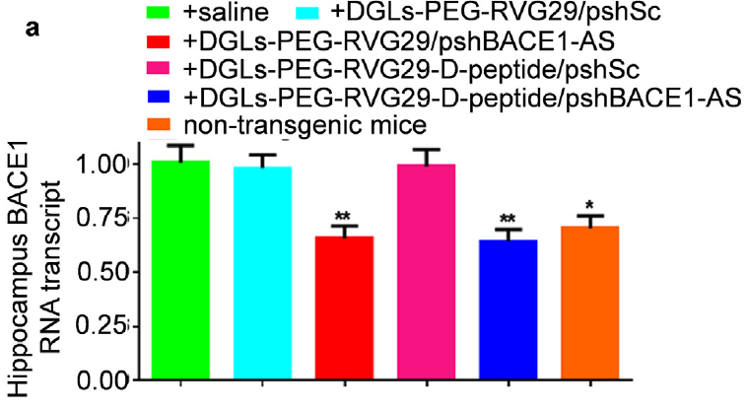
The Example (#2)
Nanoparticle Complex ↓ BACE1 in AD Mice
Saline
+DGLs-PEG-RVG29/pshSc
+DGLs-PEG-RVG29/BACE1-AS
+DGLs-PEG-RVG29-D-peptide/pshSc
+DGLs-PEG-RVG29-D-peptide/
BACE1-AS
Non-Transgenic
Liu, Y et al. 2016. Biomaterials 80, 33-45.

Slide 29
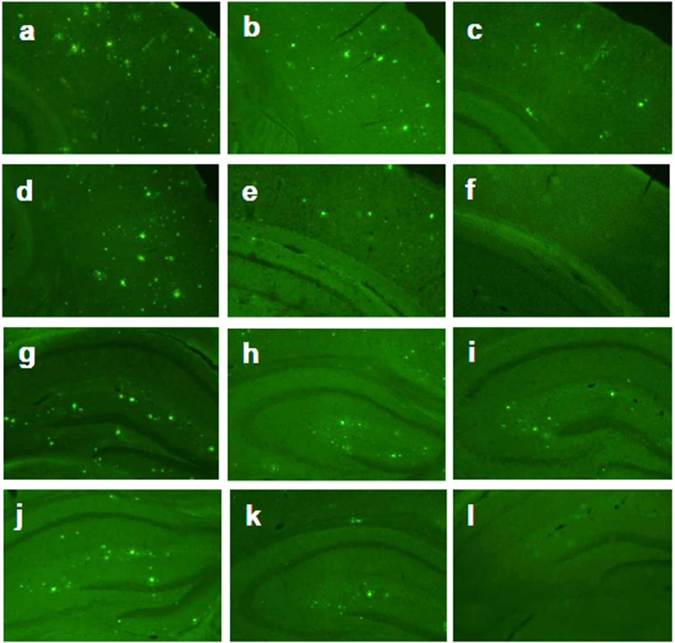
The Example (#2)
Nanoparticle Complex ↓ Amyloid Plaques in AD Mice
Cortex
Saline
+DGLs-PEG-RVG29/pshSc
+DGLs-PEG-RVG29/BACE1-AS
+DGLs-PEG-RVG29-D-peptide/pshSc
+DGLs-PEG-RVG29-D-peptide/
BACE1-AS
Non-Transgenic
Saline
+DGLs-PEG-RVG29/pshSc
+DGLs-PEG-RVG29/BACE1-AS
Hippocampus
Liu, Y et al. 2016. Biomaterials 80, 33-45.
+DGLs-PEG-RVG29-D-peptide/pshSc
+DGLs-PEG-RVG29-D-peptide/
BACE1-AS
Non-Transgenic

Slide 30
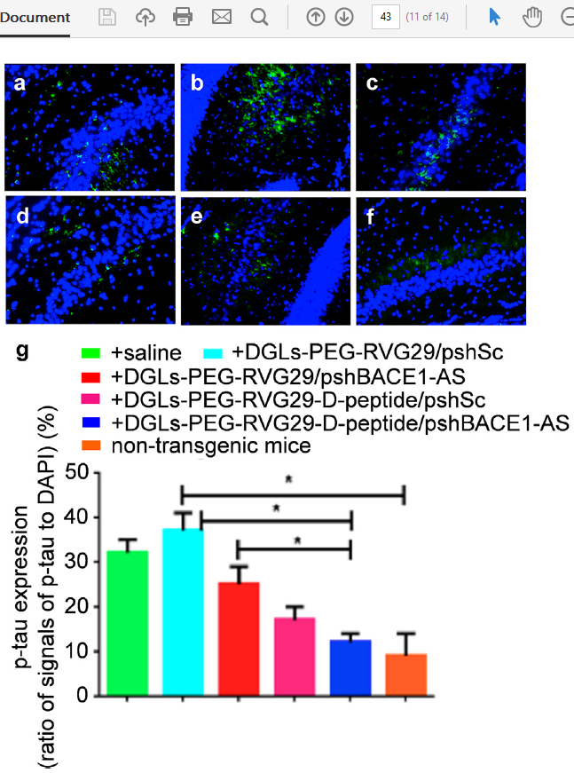
The Example (#2)
Nanoparticle Complex ↓ tau in AD Mice
Liu, Y et al. 2016. Biomaterials 80, 33-45.

Slide 31
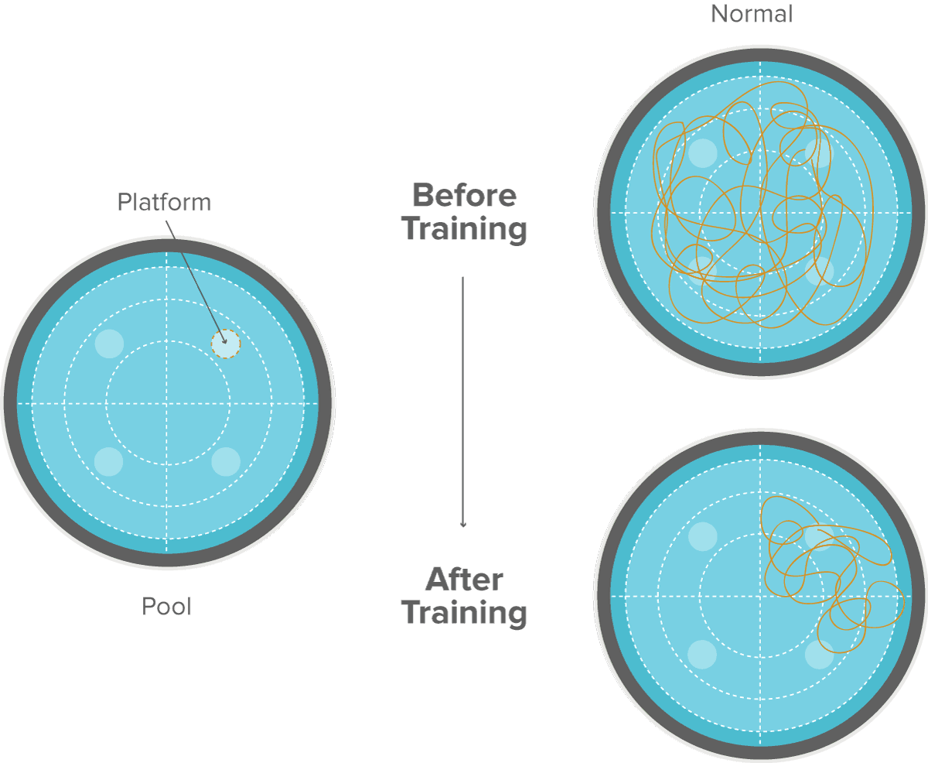
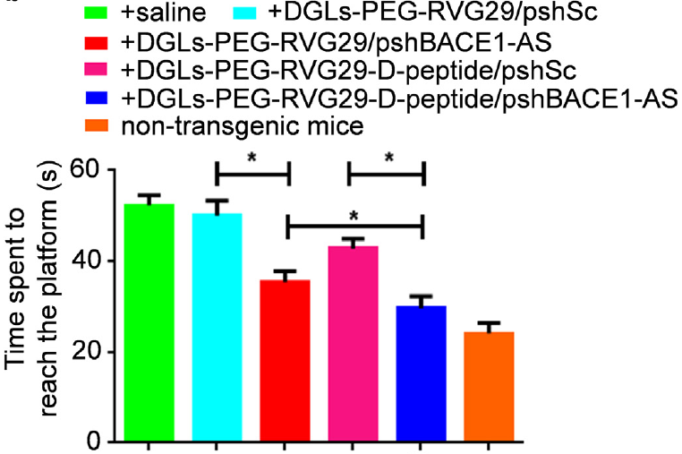
The Example (#2)
Nanoparticle Complex Rescues Memory in AD Mice
Liu, Y et al. 2016. Biomaterials 80, 33-45.

Slide 32
The Example (#2)
Nanoparticle Complex uses Targeted Approach to Treat AD
So…Nanoparticles can help carry genes and drugs across the BBB to treat AD…
But can even more selectivity be achieved?
And what about PTSD?
Liu, Y et al. 2016. Biomaterials 80, 33-45.

Slide 33
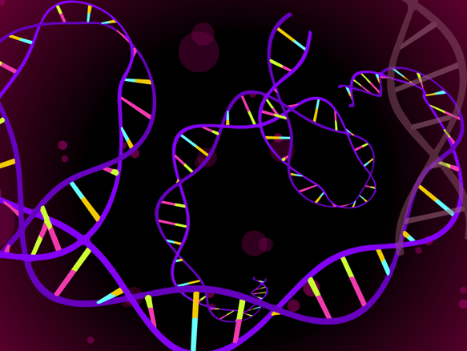
The Recap
The Goal:
Precise Delivery of Therapeutic Agents
Fear is mediated by Orx₁ activity in the CeA
  Inhibition of CeA Orx₁ can enhance extinction of fear memories
Dendrigraft NPs can transport AD therapies across the BBB
  Reduce amyloid plaques (BACE1-AS) and inhibit tau aggregation (D-peptide)
    Restore memory in AD mice (Morris Water Maze)
This is where things get weird hypothetical…
Can we use NPs to target CeA Orx₁-containing cells?

Slide 34


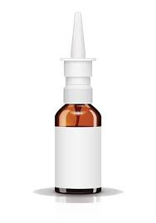

The Hypothetical

Slide 35
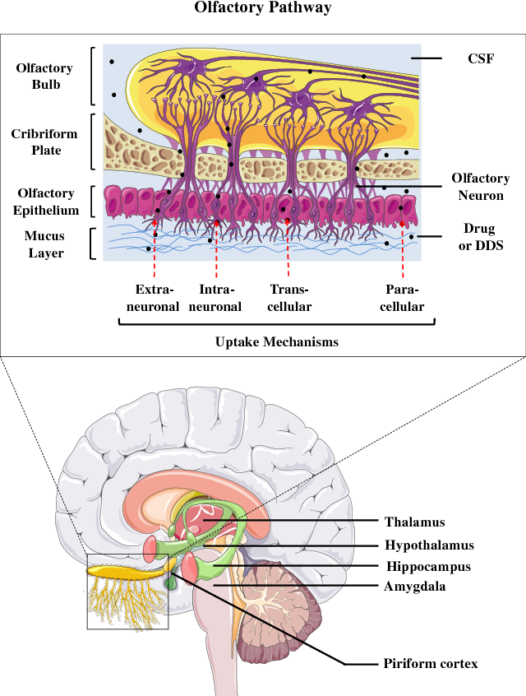
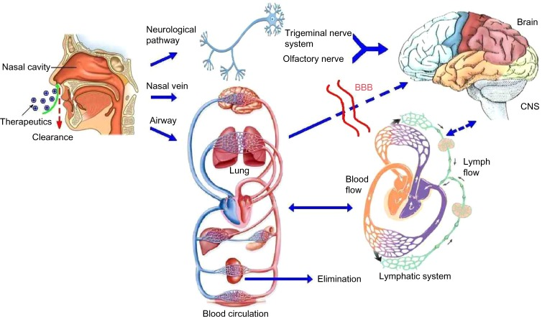
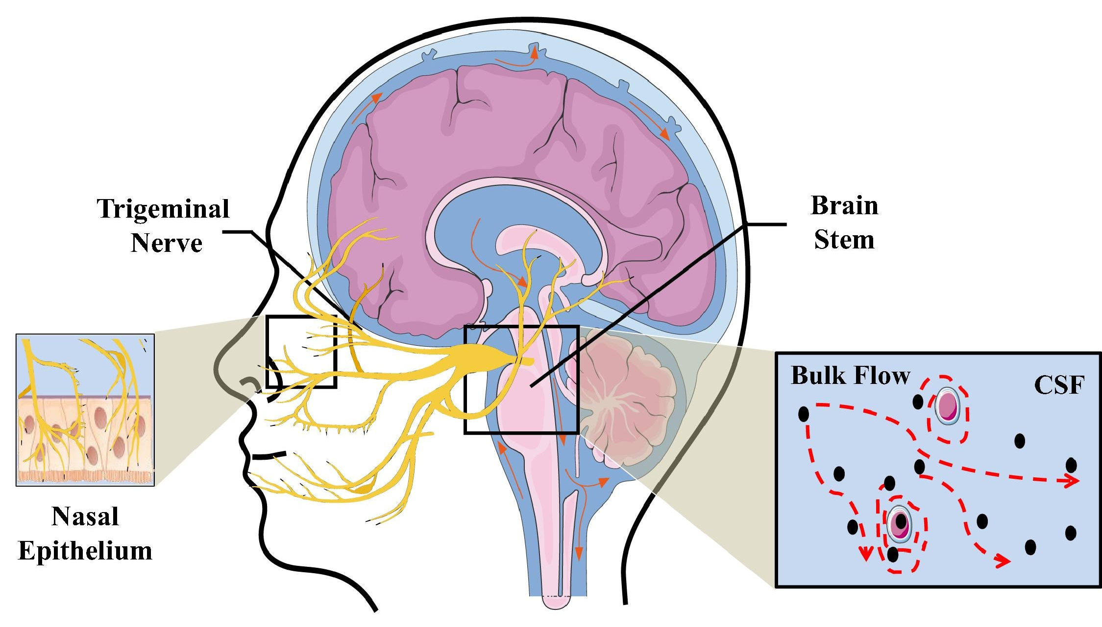
The Hypothetical
Nose-to-Brain Pathway to Bypass BBB?
Lu, C.-T., et al. 2014. International Journal of Nanomedicine 9: 2241-2257.
Samaridou, E. and M. J. Alonso 2018. Bioorg Med Chem 26(10): 2888-2905.

Slide 36
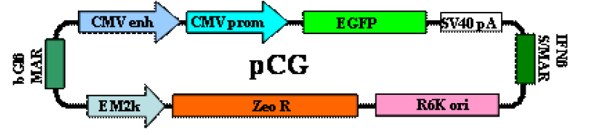
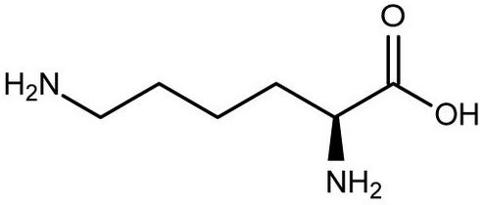
The Hypothetical
Nose-to-Brain Pathway
Frontal Cortex
+
X 30
How do we get more specific?
Striatum
Cytomegalovirus Enhancer
Cytomegalovirus Promoter
Enhanced Green Fluorescent Protein
Simian Virus Poly A
Nuclear Matrix Attachment Site
E. coli Replication Control Site
Zeocin Resistance
Bacterial Promoter
Nuclear Matrix Attachment Site
Midbrain
Harmon, B., et al. 2014. Gene Therapy 21(5): 514.

Slide 37


The Hypothetical
Promoter-Dependent Transcription

Slide 38
The Hypothetical
Promoter-Dependent Transcription
Glu
IL
Orx₁ Promoter Specification?
mPFC
CeA
PrL
EC
lCeA
PAG
Glu
lcCeA
Glu
“Off”
mCeA
dl/lPAG
Mc
LA
“On”
Glu
mpITC
GABA
GABA
lpITC
GABA
GABA
Glu
ACh
Glu
GABA
vlPAG
GABA
Glu
HYPOTHALAMUS
(PeF)
ACh
SC
GABA
BLA
FEAR RESPONSE

Slide 39
The Hypothetical
Plan A
shRNA-Orx₁
+ NPs
Nas-nofear
Short hairpin Orx₁
But wait...
Orx₁ is found throughout the CNS...remember?

Slide 40


The Hypothetical
Plan B
Find specifically what cells in the Amygdala express Orx₁
Rspo2
Ppp1r1b
Kim, J, Pignatelli, M, Xu, S, Itohara, S & Tonegawa, S 2016. Nature Neuroscience 19, 1636.

Slide 41
The Hypothetical
Plan B
Apply promoter-dependent transcription strategy
Orx₁-Ppp1r1b-shRNAOrx₁-WPRE
+ NPs
Orx₁ Promoter
Ppp1r1b Promoter
Short hairpin Orx₁
Woodchuck Hepatitis Virus Postranscriptional Regulatory Element
Nas-nofear
PLUS

Slide 42
The Hypothetical
Plan B
Apply promoter-dependent transcription strategy
Orx₁-Ppp1r1b-shRNAOrx₁-WPRE
+ NPs
+ C 56 (Orx₁ Antagonist)
Orx₁ Promoter
Ppp1r1b Promoter
Short hairpin Orx₁
Woodchuck Hepatitis Virus Postranscriptional Regulatory Element
PEG
Nas-nofear
PLUS
XTRA
DGL

Slide 43

The Hypothetical
Plan B
Considerations:
Insertional Mutagenesis
Immune Response
DNase Activity
Low Transfection
Off-Target Effects

Slide 44

The Take Home Message(s)
Orx₁ in the CeA regulates Fear
NPs can carry therapeutic agents across BBB to treat AD
NPs can assist in nose-to-brain delivery of genes
NPs potentially used for specific, accurate, exact, on-point, and direct targeting for the treatment of PTSD

